Slide 1


ASSIGNMENT II 22.DEVOPS TOOLCHAIN
DevOps Toolchain Overview
CI , CD , Testing & Monitoring Tools
By :
Rishu Raj (500119484 B1) and Krrish Batra (500119657 B2)

Slide 2


What is DevOps ?
DevOps is a modern approach to software development that brings development and operations teams together to deliver applications faster and more reliably. It focuses on collaboration, automation, and continuous improvement across the software lifecycle
DevOps LifeCycle
The DevOps lifecycle is a continuous, iterative process, often visualized as an infinity loopcombining software development and IT operations to shorten development cycles and deliver high-quality software frequently. Key phases include Plan, Code, Build, Test, Release, Deploy, Operate, and Monitor, driven by automation and constant feedback

Slide 3


WHAT IS A DEVOPS TOOLCHAIN?
A DevOps toolchain is a set of interconnected tools designed to streamline and automate software development and operations processes.
It facilitates collaboration by integrating tools supporting coding, building, testing, deployment, version control, monitoring tasks, and incident/issue response.
By automating these tasks, the DevOps Toolchain helps ensure the continuous delivery of software and services, minimizing the need for manual intervention.

Slide 4
WHY DO WE NEED DEVOPS TOOLCHAIN?
A DevOps Toolchain facilitates software and infrastructure development, delivery, and optimization.
Accelerated Development Cycles
Enhanced Collaboration and Communication
Increased Deployment Frequency
Improved Quality and Reliability
Reduce problem mitigation time or Faster mean time to repair

Slide 5

DevOps Toolchain in the Lifecycle
DevOps toolchain has multiple tools that automate the entire DevOps lifecycle, from writting code to monitoring.
Plan and Collaboration
Build & Continuous Integration
The cycle starts with defining project goals and writing the initial code. Collaboration tools, version control systems, and issue-tracking software keep teams aligned, facilitating project management and progress tracking.
Tool:
Jira: A project management tool often used in agile software development and DevOps workflows.
During this stage, the code from developers is automatically integrated and built into executable software. Continuous Integration tools ensure that new code changes do not break the existing system.
Tool:
Jenkins: An open-source automation server that supports building, testing, and deploying applications.
Code-Version Control Systems
In this stage, developers write and manage source code. Version control systems keep track of code changes and allow multiple developers to collaborate without conflicts.
Tool:
Git: A widely-used distributed version control system that allows developers to track changes in code and collaborate.

Slide 6

Test – Automated Testing
In the testing stage, the application is automatically tested to identify bugs, vulnerabilities, and performance issues before deployment.
Tool:
SonarQube: A tool for continuous inspection of code quality, focusing on bug detection and vulnerability management.
Package & Artifact Storage
Once the software is built and tested, the resulting build artifacts (libraries, packages, or container images) must be stored in a repository so they can be reused or deployed later.
Tool:
Nexus Repository: A repository manager for storing and retrieving build artifacts, dependencies, and containers.
Containerization & Deployment
This stage focuses on deploying the application to production environments. Containerization ensures applications run consistently across different environments.
Tool:
Docker: A tool for containerizing applications to ensure consistency across environments.

Slide 7
Configuration Management
Configuration management ensures that servers and environments are configured consistently across development, testing, and production systems.
Tool:
Ansible – An open-source tool for automating configuration management, provisioning, and deployment.
Infrastructure as Code
Infrastructure as Code allows developers to manage infrastructure using code instead of manual configuration, making infrastructure scalable and repeatable.
Tool:
Terraform: An infrastructure-as-code tool that allows you to define cloud and on-premise resources in a declarative language.
Monitoring & Logging
Configuration management ensures that servers and environments are configured consistently across development, testing, and production systems.
Tool:
Prometheus: An open-source system monitoring and alerting toolkit designed for reliability.

Slide 8

Security (DevSecOps)
Security is integrated throughout the DevOps lifecycle to detect vulnerabilities and protect applications and infrastructure.
Tool:
Twistlock: A security platform designed for containers and cloud-native applications.
Cloud Platforms
Cloud providers offer scalable infrastructure and services to host applications and support DevOps pipelines.
Tool:
Amazon Web Services (AWS): Cloud computing services with various offerings for DevOps, including Elastic Beanstalk, CloudFormation, and CodePipeline.

Slide 9
CI Pipeline: How It Works
Developer pushes code
▼
CI server detects change
▼
Build and compile code
▼
Run automated tests
PASS
Code merged
FAIL
Alert sent

Slide 10
CD Pipeline Stages
›
›
›
CI passed
(code merged)
Build
artifact
Staging
env test
Production
release

Slide 11
Real-World Example: DevOps Toolchain in a Web Application
Use Case:
A company is developing and maintaining an e-commerce web application where developers continuously add new features, fix bugs, and improve performance. The DevOps toolchain automates the entire process from development to monitoring.
Developers plan work using
Jira → write code using Git → CI tools like Jenkins build and test the code → artifacts stored in Nexus Repository → containers created with Docker → deployment managed using Kubernetes → infrastructure provisioned with Terraform → application monitored using Prometheus and Grafana.

Slide 12
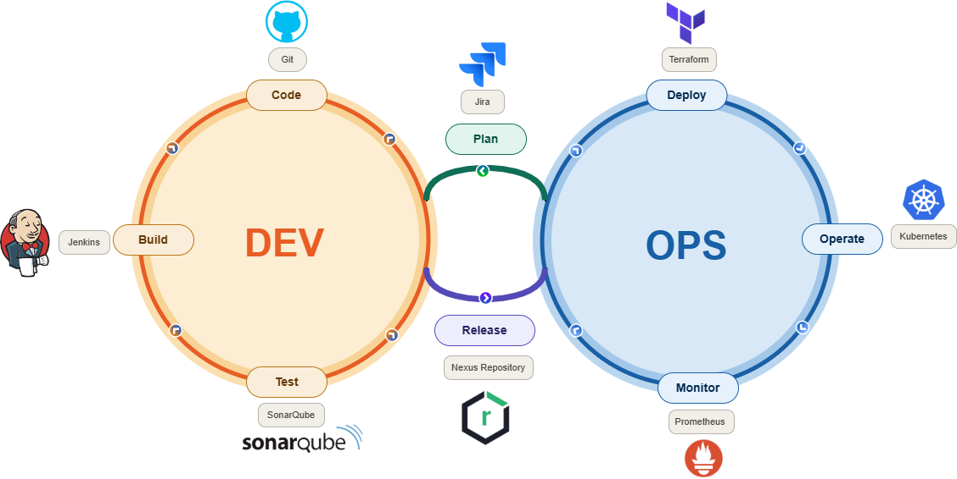
DevOps Toolchain LifeCycle

Slide 13
References
What is a DevOps Toolchain
link:
https://www.xmatters.com/blog/what-is-a-devops-toolchain-and-how-does-it-work
Used for:
Understanding the concept and working of DevOps toolchain.
Comment:
Offers a good conceptual explanation and real-world insight into why DevOps tools integrate to automate the software development lifecycle.
DevOps Tools Overview
link:
https://dev.to/meghasharmaaaa/devops-toolchain-mlo
Used for:
Understanding different tools used in the DevOps toolchain (Git, Jenkins, Docker, Kubernetes, etc).
Comment:
Provides a clear and beginner-friendly overview of DevOps tools and how they fit into the lifecycle, though the depth is mostly introductory.

Slide 14
Thank You

